Slide 1
iJ Series
35 to 100A POL
DC-DC Converters

Slide 2
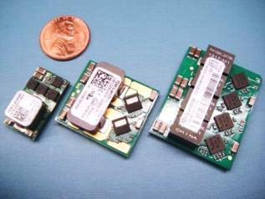
iJ Overview
8 - 14VDC Input, Non-Isolated
35A, 60A and 100A Output Currents
0.6 to 3.3V, 2.0V or 1.5V Output Voltages
Small Surface Mount Packages
PMBus read and write compliant

Slide 3
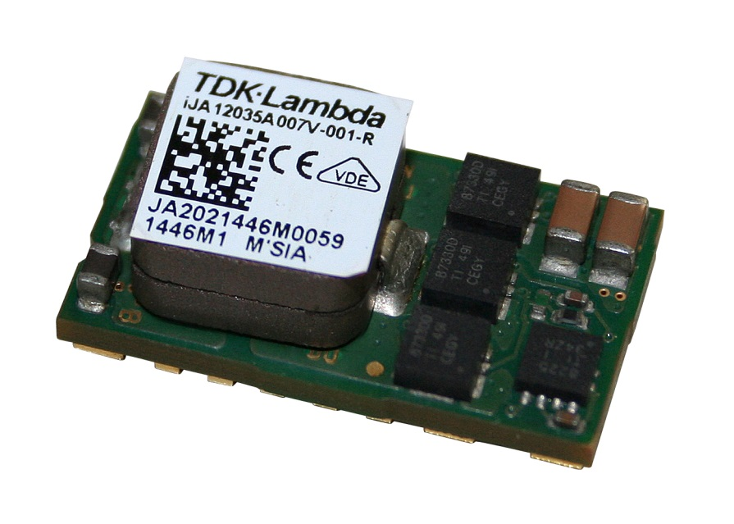
iJA35A Overview
8 - 14VDC Input, Non-Isolated
35A Output Current
0.6 – 3.3V Output Voltage
22.9 x 12.7 x 9.7mm Surface Mount Package
PMBus read and write compliant

Slide 4
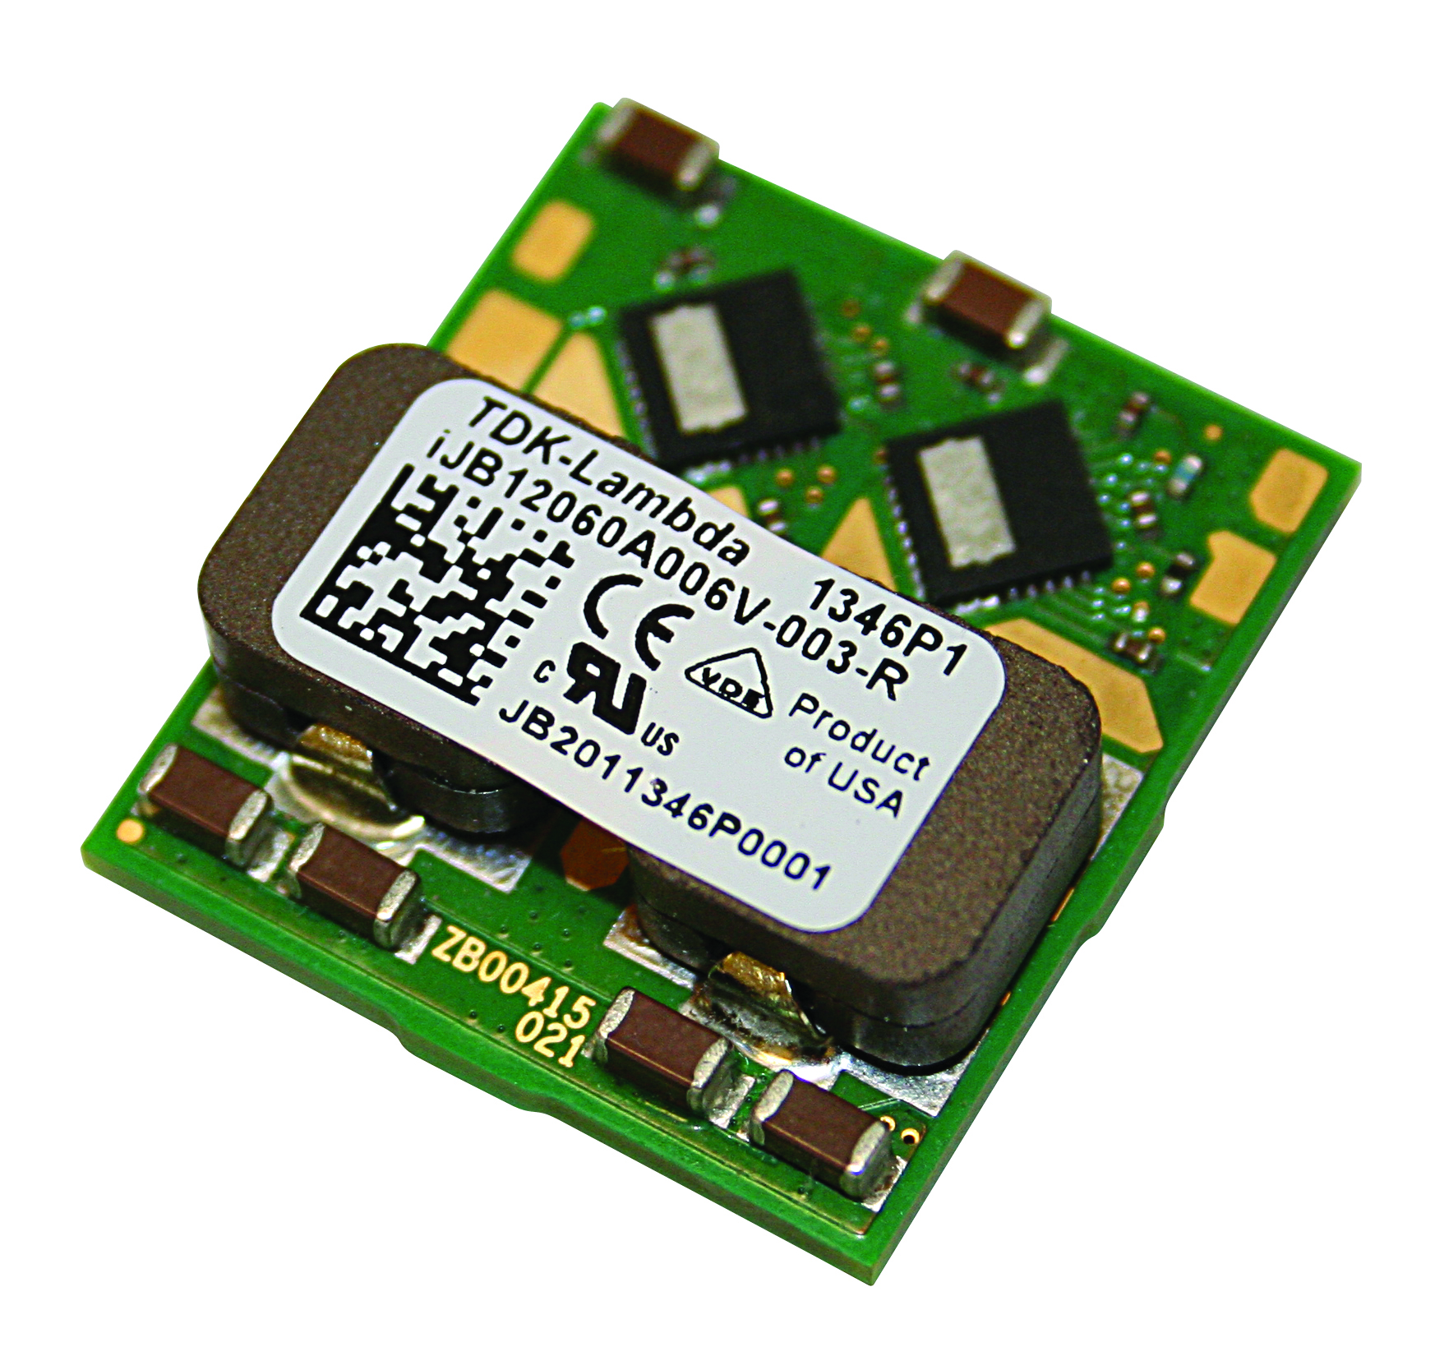
iJB Overview
8 - 14VDC Input, Non-Isolated
60A Output Current
0.6 – 2.0V Output Voltage
26.8 x 24.1 x 9.5mm Surface Mount Package
PMBus read and write compliant

Slide 5
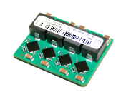
iJC Overview
8 - 14VDC Input, Non-Isolated
100A Output Current
0.6 – 1.5V Output Voltage
28.0 x 35.0 x 10.0mm Surface Mount Package
PMBus read and write compliant

Slide 6
Next Generation Technology - 1
Digital, not analogue control
  Advanced control – including self-adjusting control loop
  Calibrated and extremely accurate current read-back
  Parallel / Multi-phase operation easily achievable
    Includes interleaving
  PMBus commands supported; simplifies system design
  Full feature GUI that allows user to change many parameters

Slide 7
Next Generation Technology - 2
Advanced control
  Real time loop compensation
    Adapts to different load impedances & load capacitance
    Adjusts for component tolerances and aging
  No need to tune the control loop for each application

Slide 8
Next Generation Technology - 3
Calibrated and accurate current and temperature read-back
  Usually this information is hard to get accurately
  iJB current read-back is accurate with within 1%
  Can be used to adjust the system accordingly

Slide 9
Next Generation Technology - 4
Simplify system design
Current and Voltage monitor
Traditional analog approach with discrete power management
POL
Load
device
Vin
Vout
Sequence controller
Voltage adjust + margin
New approach with Digital Power Management
POL
Load
device
Space savings
Easy design and layout
Lossless, accurate current sense
Parallel possible, no load to partition
Vin
Vout
PMBus
(Configure, sequence and monitor)

Slide 10
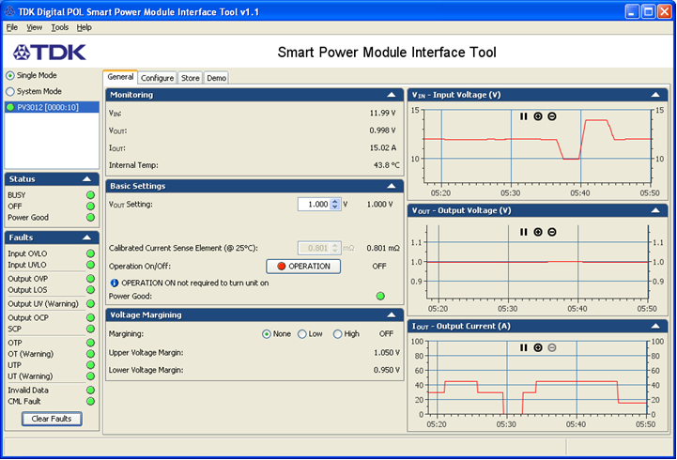
Next Generation Technology - 5
GUI available to set values and commands

Slide 11
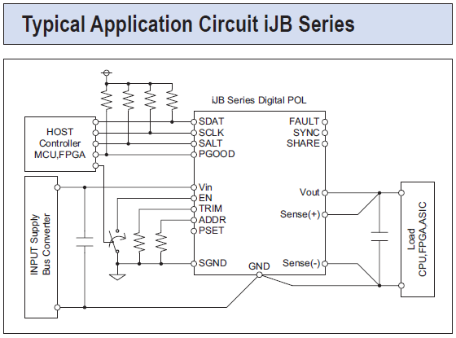
Key Points - 1

Slide 12
Key Points - 2
Remote on/off
Address setting for PMBus
Parallel connection (does not need PMBus connection)
Trim pin
DC Good
Configurable sequencing

Slide 13
Certifications
EN 60950-1 2nd Edition
UL 60950-1 2nd Edition
CSA C22.2 No. 60950-1-03 2nd Edition
CE Mark for LVD and RoHS2

Slide 14
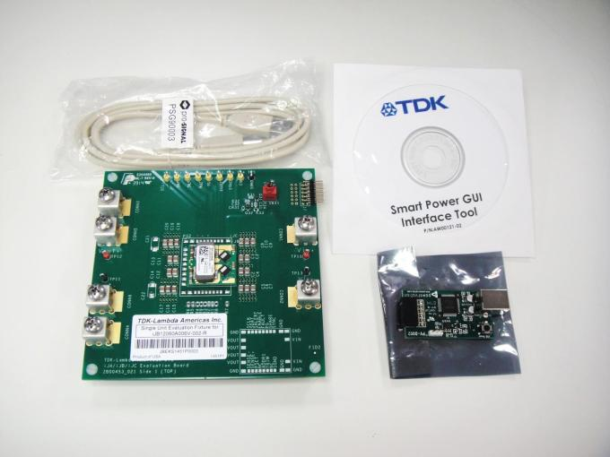
Evaluation Kit
Software
CD-ROM
USB cable
PMBus Dongle
EVAL Board

Slide 15
Part numbering
iJB12 060A 006V-002-R
Nominal Input Voltage
iJA12 = 12V input
iJB12 = 12V input
iJC12 = 12V input
Output Current
035A = 35A
060A = 60A
100A = 100A
Output Voltage
Minimum
006V = 0.6V
Options
(See datasheet)
-R = RoHS

